Slide 1
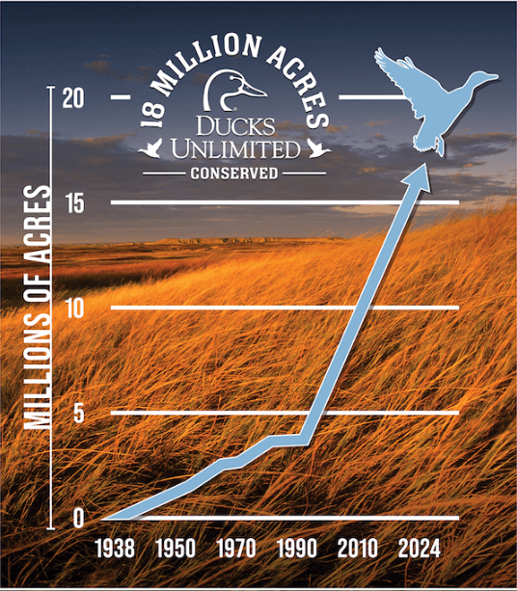
Farm Bill and Conservation
Julia Peebles
Director of Agriculture and Sustainability Policy
Ducks Unlimited

Slide 2
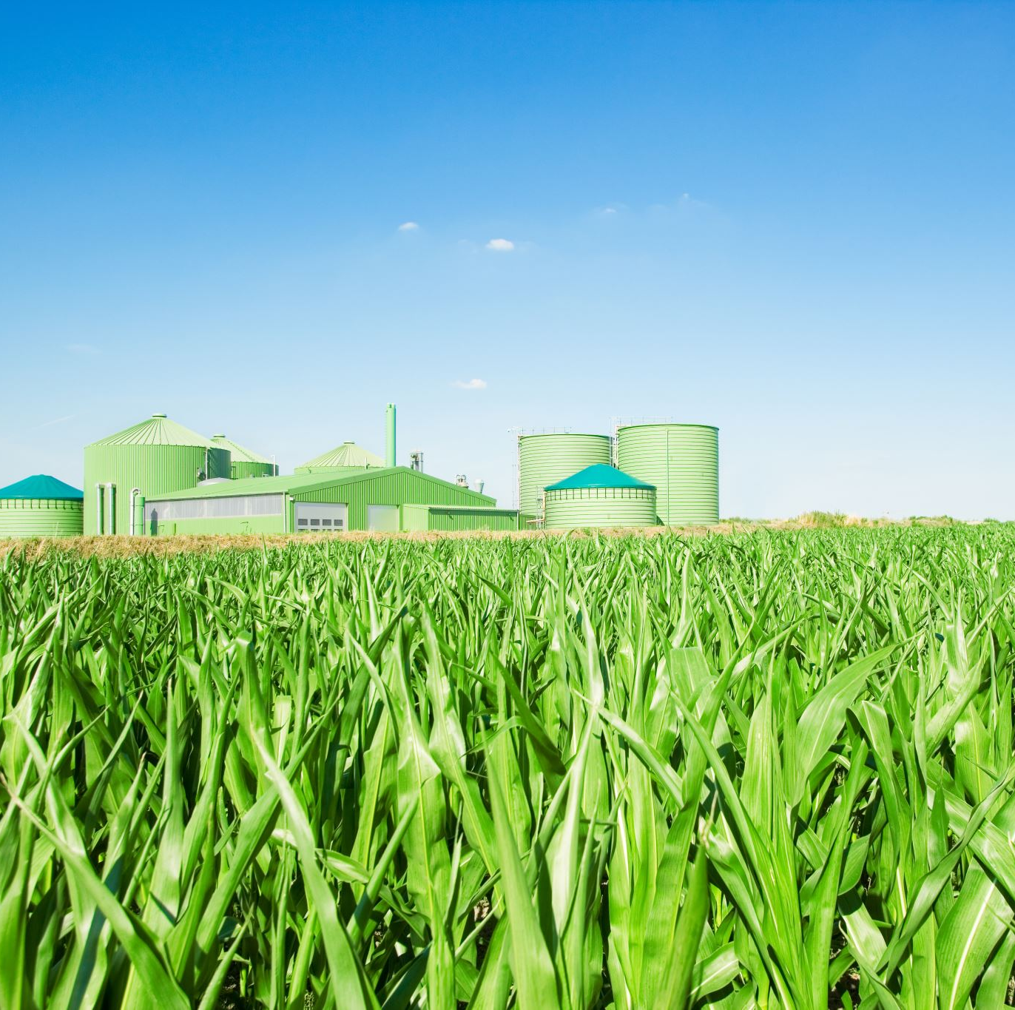
Legislation More Than 90 Years In The Making
Multiyear legislation
Covers the agricultural supply chain
Originally introduced as part of President Franklin D. Roosevelt's New Deal, Agricultural Adjustment Act of 1933 (AAA).
The 1985 Food Security Act
set aside 40 to 45 million acres of highly erodible land for soil-conserving purposes.
marked the inception of conservation compliance standards and Conservation Reserve Program (CRP).
Notes:
Titles: commodities (I), conservation (II), trade (III), nutrition (IV), credit (V), rural development (VI), research, extension & related matters (VII), forestry (VIII), energy (IX), horticulture (X), crop insurance (XI), misc. (XII)

Slide 3
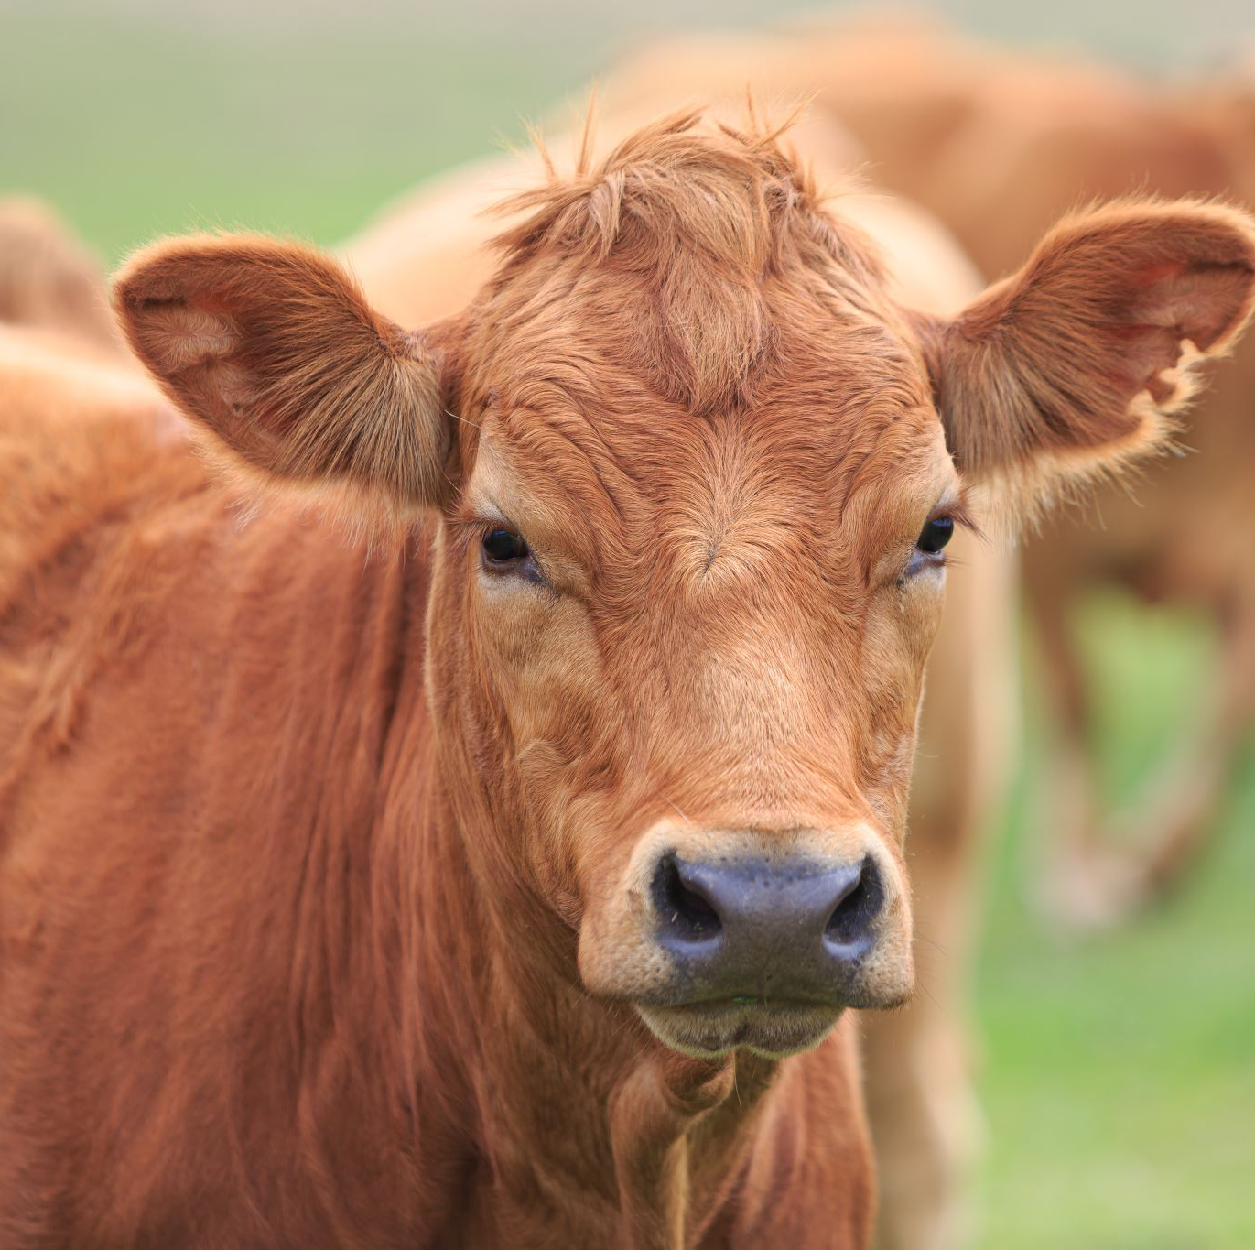
The Importance of Title II
The Farm Bill is the single largest source of federal funding for private lands conservation.
With nearly 70% of land in the United States under private ownership, effective conservation of the nation’s wildlife depends on the type of voluntary, private-land conservation programs included in the Farm Bill.
Enrollment in Title II conservation programs reached 466 million acres in 2018—roughly equivalent to the public land area managed by federal agencies.

Slide 4
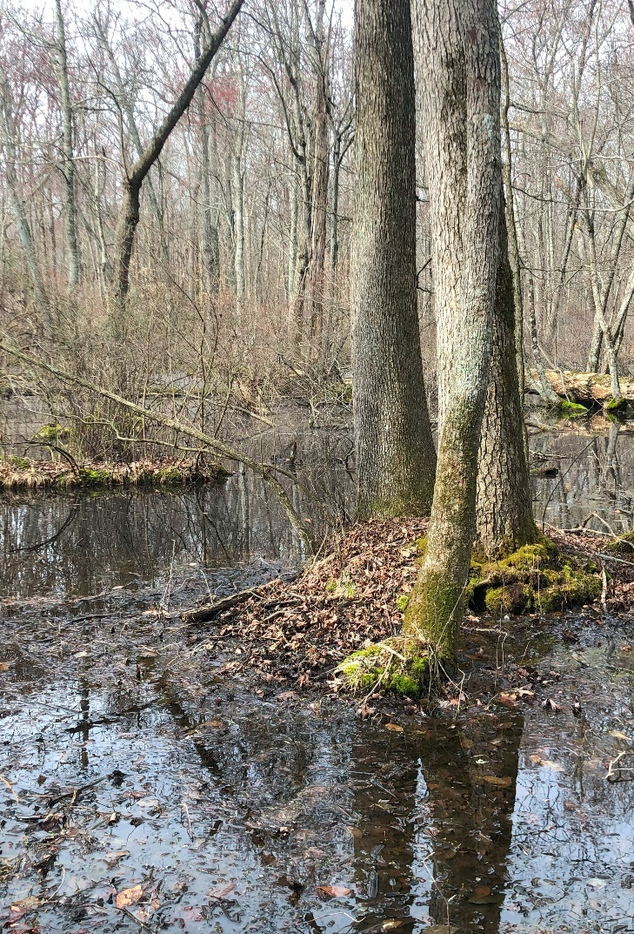
The Agricultural Conservation Easement Program (ACEP)
ACEP is divided into two subprograms: the Wetland Reserve Easement (WRE) and the Agricultural Land Easement (ALE).
WRE and ALE are permanent or long-term easements landowners voluntarily enroll in in exchange for a payment.
WRE provides:
Financial support
Environmental stewardship
Improvement on lands for the next generation
Climate benefits
DU implements over 750k acres of WRE heavily in the Lower Mississippi

Slide 5
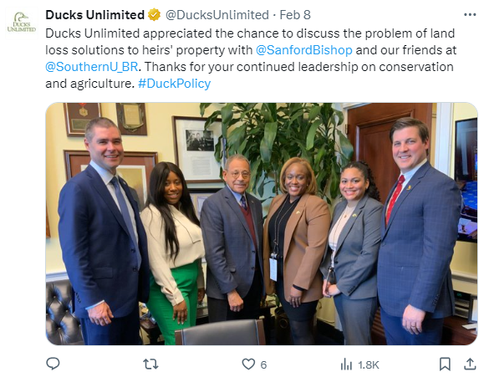
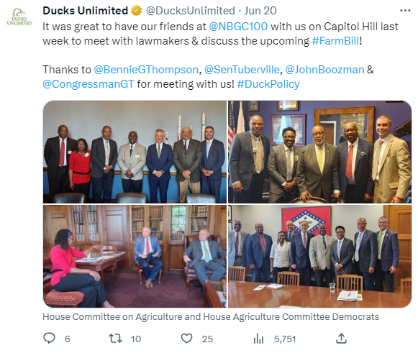
Heirs Property
Need a clear title to access conservation programs
Heirs Property Relending Program
Heirs Education and Investment to Resolve Succession of Property Act (H.R. 8198)
New provision in the House Farm Bill
Championed by Reps. Bishop (GA) and Davis (NC)

Slide 6
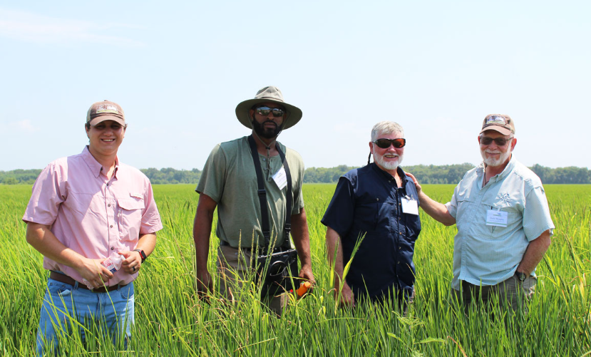
Regional Conservation Partnership Program (RCPP)
RCPP uses partnership agreements.
It encourages non-federal partners to join in efforts with producers to increase the restoration and sustainable use of soil, water, wildlife and related natural resources on regional or watershed scales.
The Rice Stewardship Partnership has generated over $110 million for rice producers.
Notes:
https://www.nrcs.usda.gov/wi/rcpp#:~:text=RCPP%20encourages%20partners%20to%20join%20in%20efforts%20with,and%20maintain%20conservation%20activities%20in%20selected%20project%20areas.

Slide 7
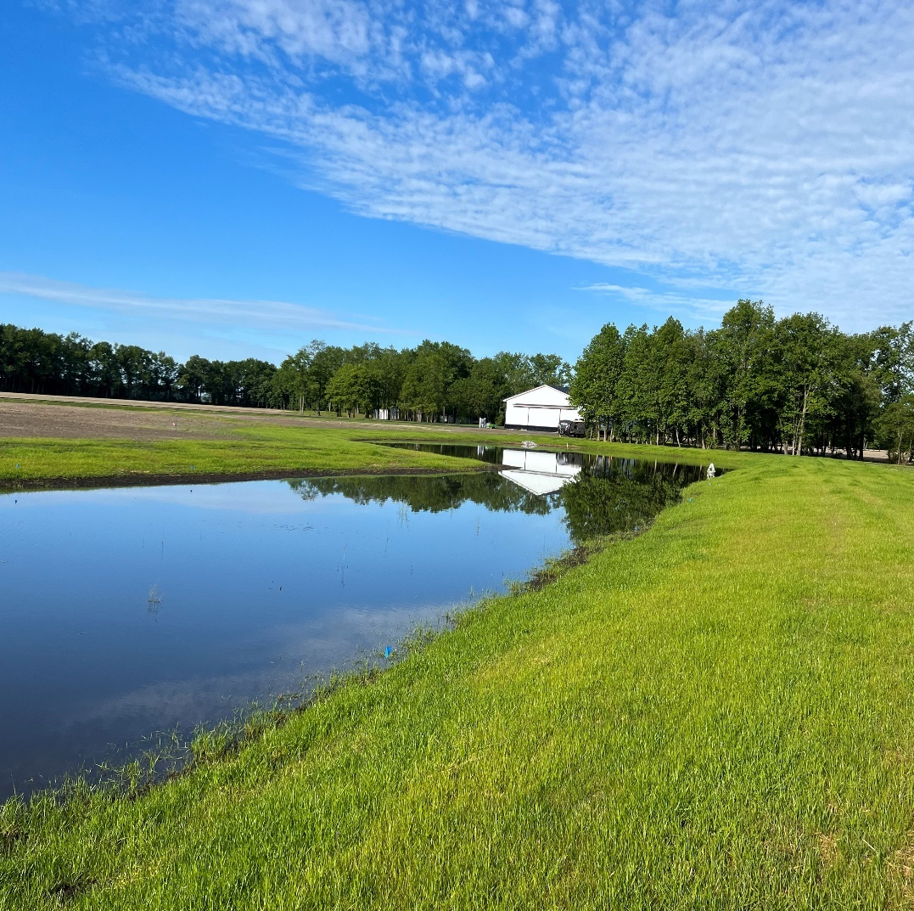
The Conservation Reserve Program (CRP)
Is a Farm Service Agency (FSA) program.
It incentivizes farmers and ranchers to remove environmentally sensitive land from production.
Utilized heavily in the Prairie Pothole Region
Historically enhances waterfowl habitat for breeding pairs in PPR
Implements wetland restoration projects, including riparian areas and enhances perennial cover

Slide 8
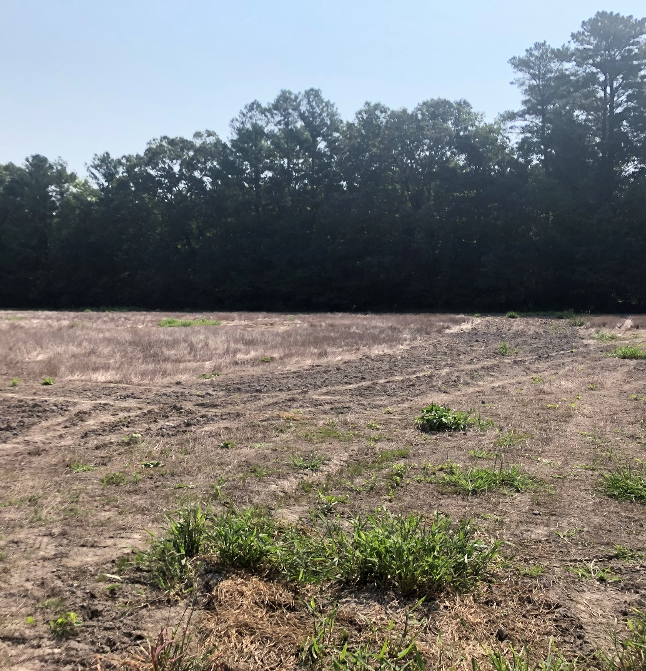
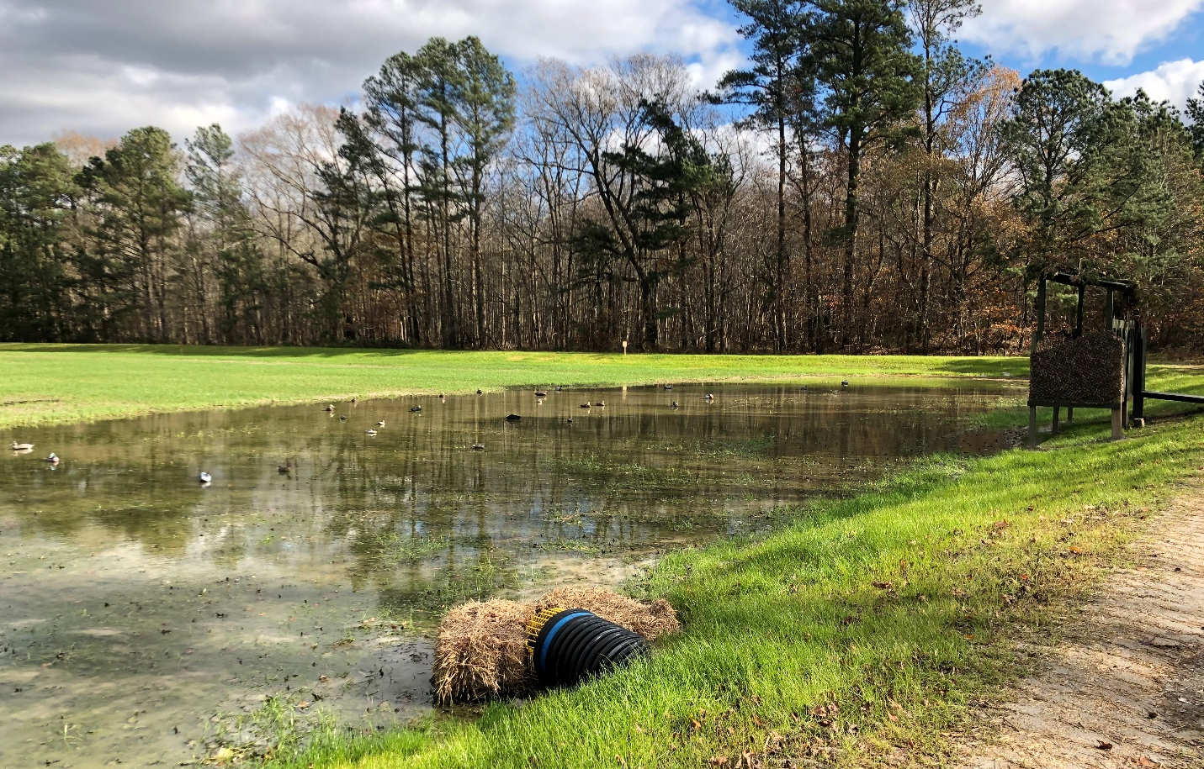
Working Lands Programs (EQIP/CSP)
These programs allow private land to remain in production while implementing conservation practices.
Examples include land leveling, water infrastructure, etc.
Includes a wildlife set-aside of 10%
Migratory Bird Resurgence Initiative
Incentives rice producers to flood their fields during winter months

Slide 9
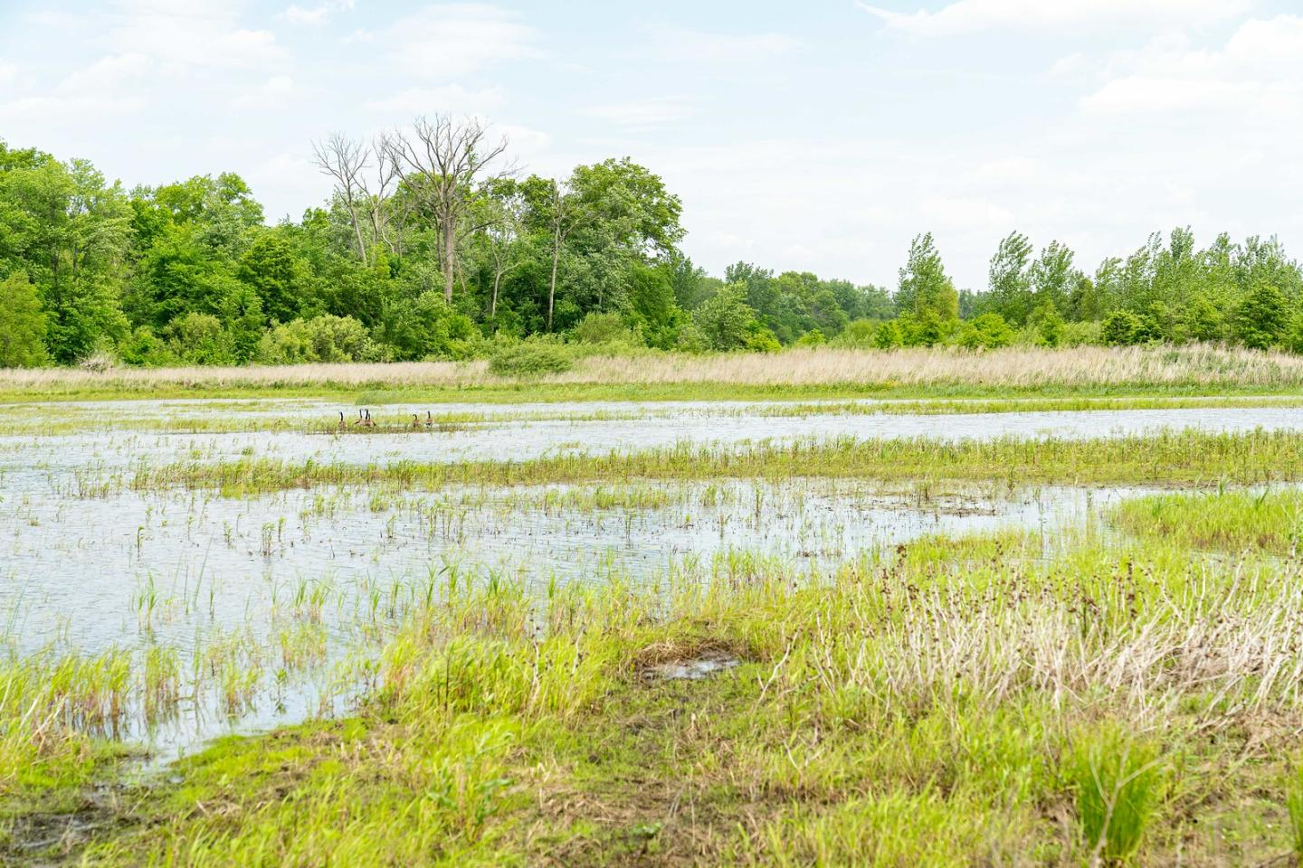
Conservation Compliance
The policy is covered under the crop insurance title
It protects wetlands from being drained
2014 Farm Bill reconnected a producer’s eligibility for farm programs to compliance
Implemented primarily in the PPR, but has implications in the South
Without the policy, 52% of the wetlands (1.371 prairie potholes) are at risk of permanent drainage
This would reduce duck population by 1.4 million breeding pairs (37% decline)
Impacts hunting opportunities and the outdoor recreation economy in the Lower Mississippi
Arkansas’ hunting season generates $236.7 million in retail sales related to waterfowl hunting
Generated $53 million in federal, state and local tax revenue
4,700 jobs in Arkansas are connected to waterfowl hunting

Slide 10
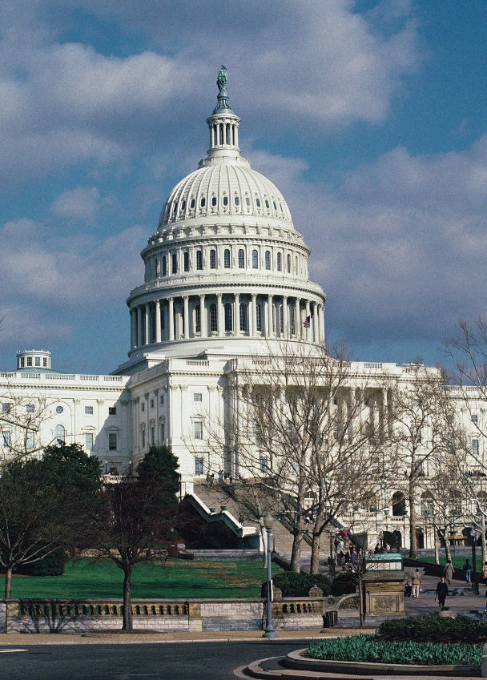
Farm Bill Status
The Farm Bill expired in Sept. 2023 and a one-year extension was implemented.
House Farm Bill (H.R. 8467)
Senate Frameworks
Pass a Farm Bill this year
Expires on Sept. 30, 2024
Likely scenario: another one-year extension
Commodity program supplemental
IRA funding

Slide 11
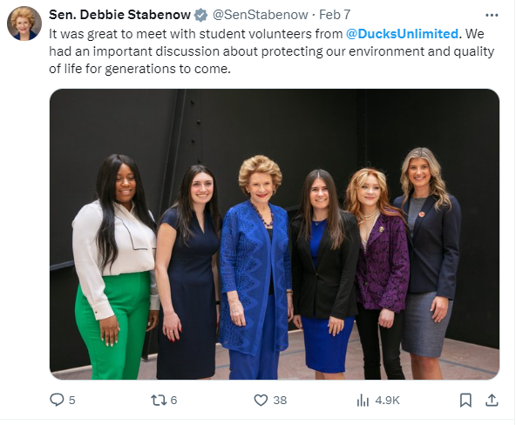
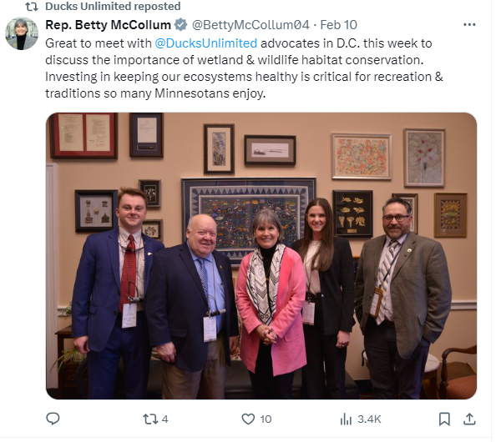
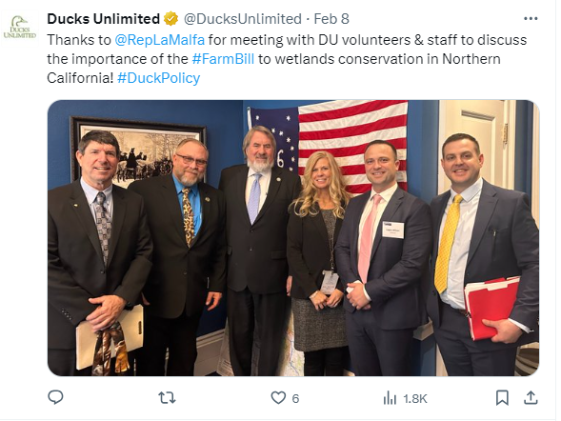
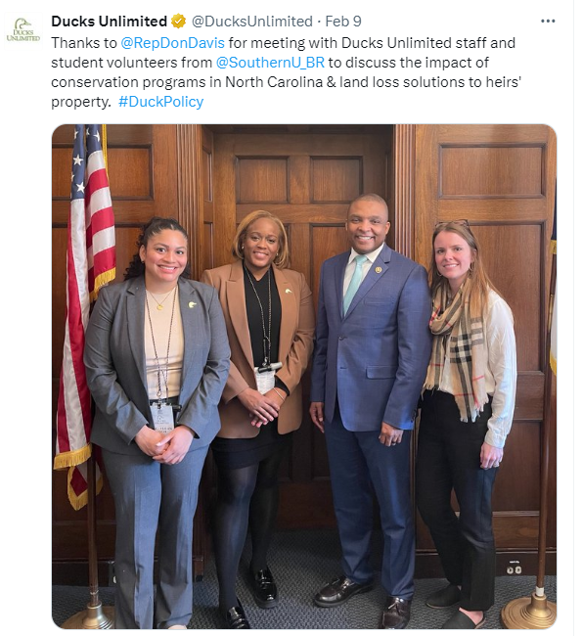
Advocacy
It’s important to have partnerships and unified coalitions made up of agricultural-related organizations
Use science and anecdotal evidence to explain policy positions and priorities
Bring constituents to D.C. to meet with lawmakers
Talk about their experience and tell their story

Slide 12
Questions Jpeebles@ducks.org

