Slide 1
Introduction to Farm Bill: Title V (Credit)
Rodney Brooks
September 26, 2024

Slide 2
Overview
What the farm bill does for credit
Overview of agricultural lending
Description
USDA Farm Service Agency
Farm Credit System
Farmer Mac
Proposed changes in H. R. 8467

Slide 3
Farm Bills Amend Permanent Agricultural Credit Authorizations
Consolidated Farm and Rural Development Act of 1961, as amended (7 U.S.C. 1921 et seq.)
USDA Farm Service Agency (FSA)
Farm Loan Program
Farm Credit Act of 1971, as amended
(12 U.S.C. 2001 et seq.)
Farm Credit System (FCS)
Farmer Mac
Farm Credit Administration (FCA)
Credit: USDA Farm Service Agency

Slide 4
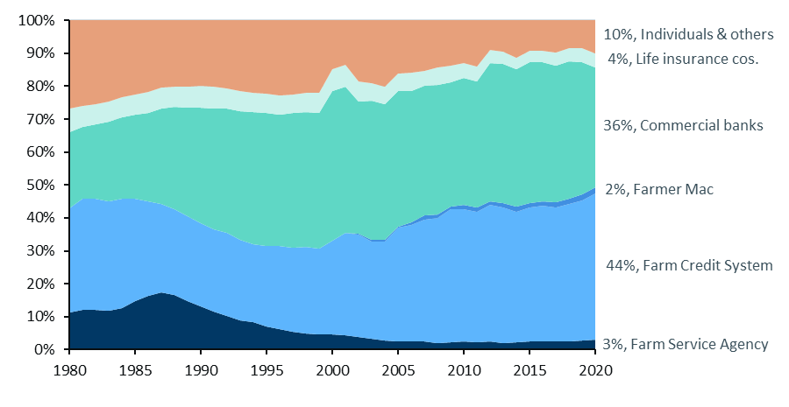
Market Shares of Directly Held Farm Debt: History Helps Understand Trends
30% of farms have farm debt
Total farm debt: $441 billion at the end of 2020
65% real estate loans
35% farm operating loans
Real estate is about 82% of farm assets
Machinery and vehicles are about 9% of assets
Source: CRS using USDA Economic Research data; see CRS Report R46768, Agricultural Credit: Institutions and Issues
Notes:
The graph is a time series of the share of farm debt lent to farmers by the different types of lenders The texts on the right describes the farm debt that is in the final column of the graph.

Slide 5
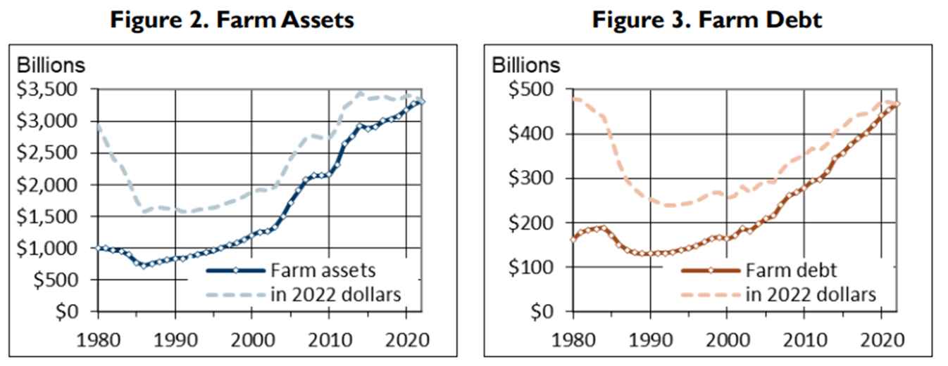
Farm Asset Growth Has Been Strong Since the End of the 1980s Farm Debt Continues to Grow; Still Below Inflation-adj. 1980s
Source: CRS using USDA Economic Research Service data; see CRS Report R46768, Agricultural Credit: Institutions and Issues

Slide 6
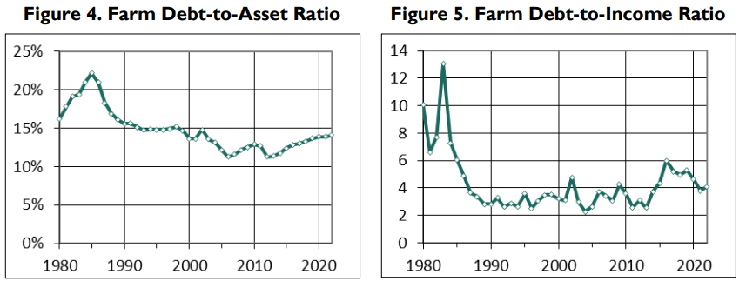
Evaluate Financial Risk with Ratios—Debts Divided by Assets, and Debt Divided by Income
Source: CRS using USDA Economic Research Service data; see CRS Report R46768, Agricultural Credit: Institutions and Issues

Slide 7
Description of lenders

Slide 8
USDA Farm Service Agency
Lender of last resort / Lender of first opportunity
Direct farm ownership and operating loans to family-sized farms unable to obtain credit elsewhere
Market share of farm loans: FSA lends about 3% directly
Guarantees repayment of qualified loans made by commercial banks and FCS
Market share of farm loans: FSA guarantees about 4%
Reservation for beginning farmers and ranchers
Targeted lending to “socially disadvantaged” farmers by race, ethnicity, and gender
Notes:
When we look at the features of the Farm Service Agency and the Farm Credit System, we see good examples of what you learn if you take a class in college about Public Economics.
That is, what is the “Market Failure” that is the reason to have government intervention in the private market?

Slide 9
USDA Farm Service Agency
Limits per borrower
Direct farm ownership loans: $600,000
Direct operating loans: $400,000
Direct microloans: $50,000
Direct emergency loans: $500,000
Guaranteed loans: $2.236 million (inflation adjusted)
Notes:
Attributes and Eligibility of loans made by the Farm Service Agency

Slide 10
USDA Farm Service Agency
Portfolio as of September 30, 2023
Direct and guaranteed loans: $33.1 billion to nearly 115,000 borrowers
Improvements to customer facing delivery of farm loans
Notes:
This information describes the size of the Farm Service Agency loan portfolio.

Slide 11
Farm Credit System
Government sponsored enterprise (GSE)
Not a government agency
Network of borrower-owned lending institutions
Four large banks allocate funds to 64 credit associations
Not a lender of last resort
Makes loans to creditworthy borrowers
For-profit lender with a statutory mandate to serve agriculture. Eligibility is limited to:
Farmers and ranchers
Certain farm-related agribusinesses
Cooperatives
Rural homeowners in towns < 2,500 population
Notes:
Shifting to describing gthe Farm Credit System,….
Here are some big features that differentiate it from the USDA farm loan program.

Slide 12
Farm Credit System
GSE provides tax exemptions for FCS and bondholders
No federal appropriations
Appropriators place a limit on FCA (the regulator) expenses
Capital raised by selling bonds on Wall Street
Through the 2nd quarter of 2024, FCS had a portfolio of $406 billion of loans, including about $254 billion of farm loans (General ag loans, production & intermediate).
Market share of farm loans: about 46% of overall U. S. Farm debt
FCS competes directly with commercial banks
Notes:
FCS gets if funding not from approprations but from the sale of bonds on Wall Street.
Some of the income from those bonds are tax exempt to bondholders, and the some profits of the profits from lending are tax exempt to the Farm Credit System entities.
FCS is the only one of the federal GSEs (like Fannie May and Freddie Mac) that is a direct lender.
The others are only a secondary market.
This puts FCS in direct competition with commercial banks for loans to farmers

Slide 13
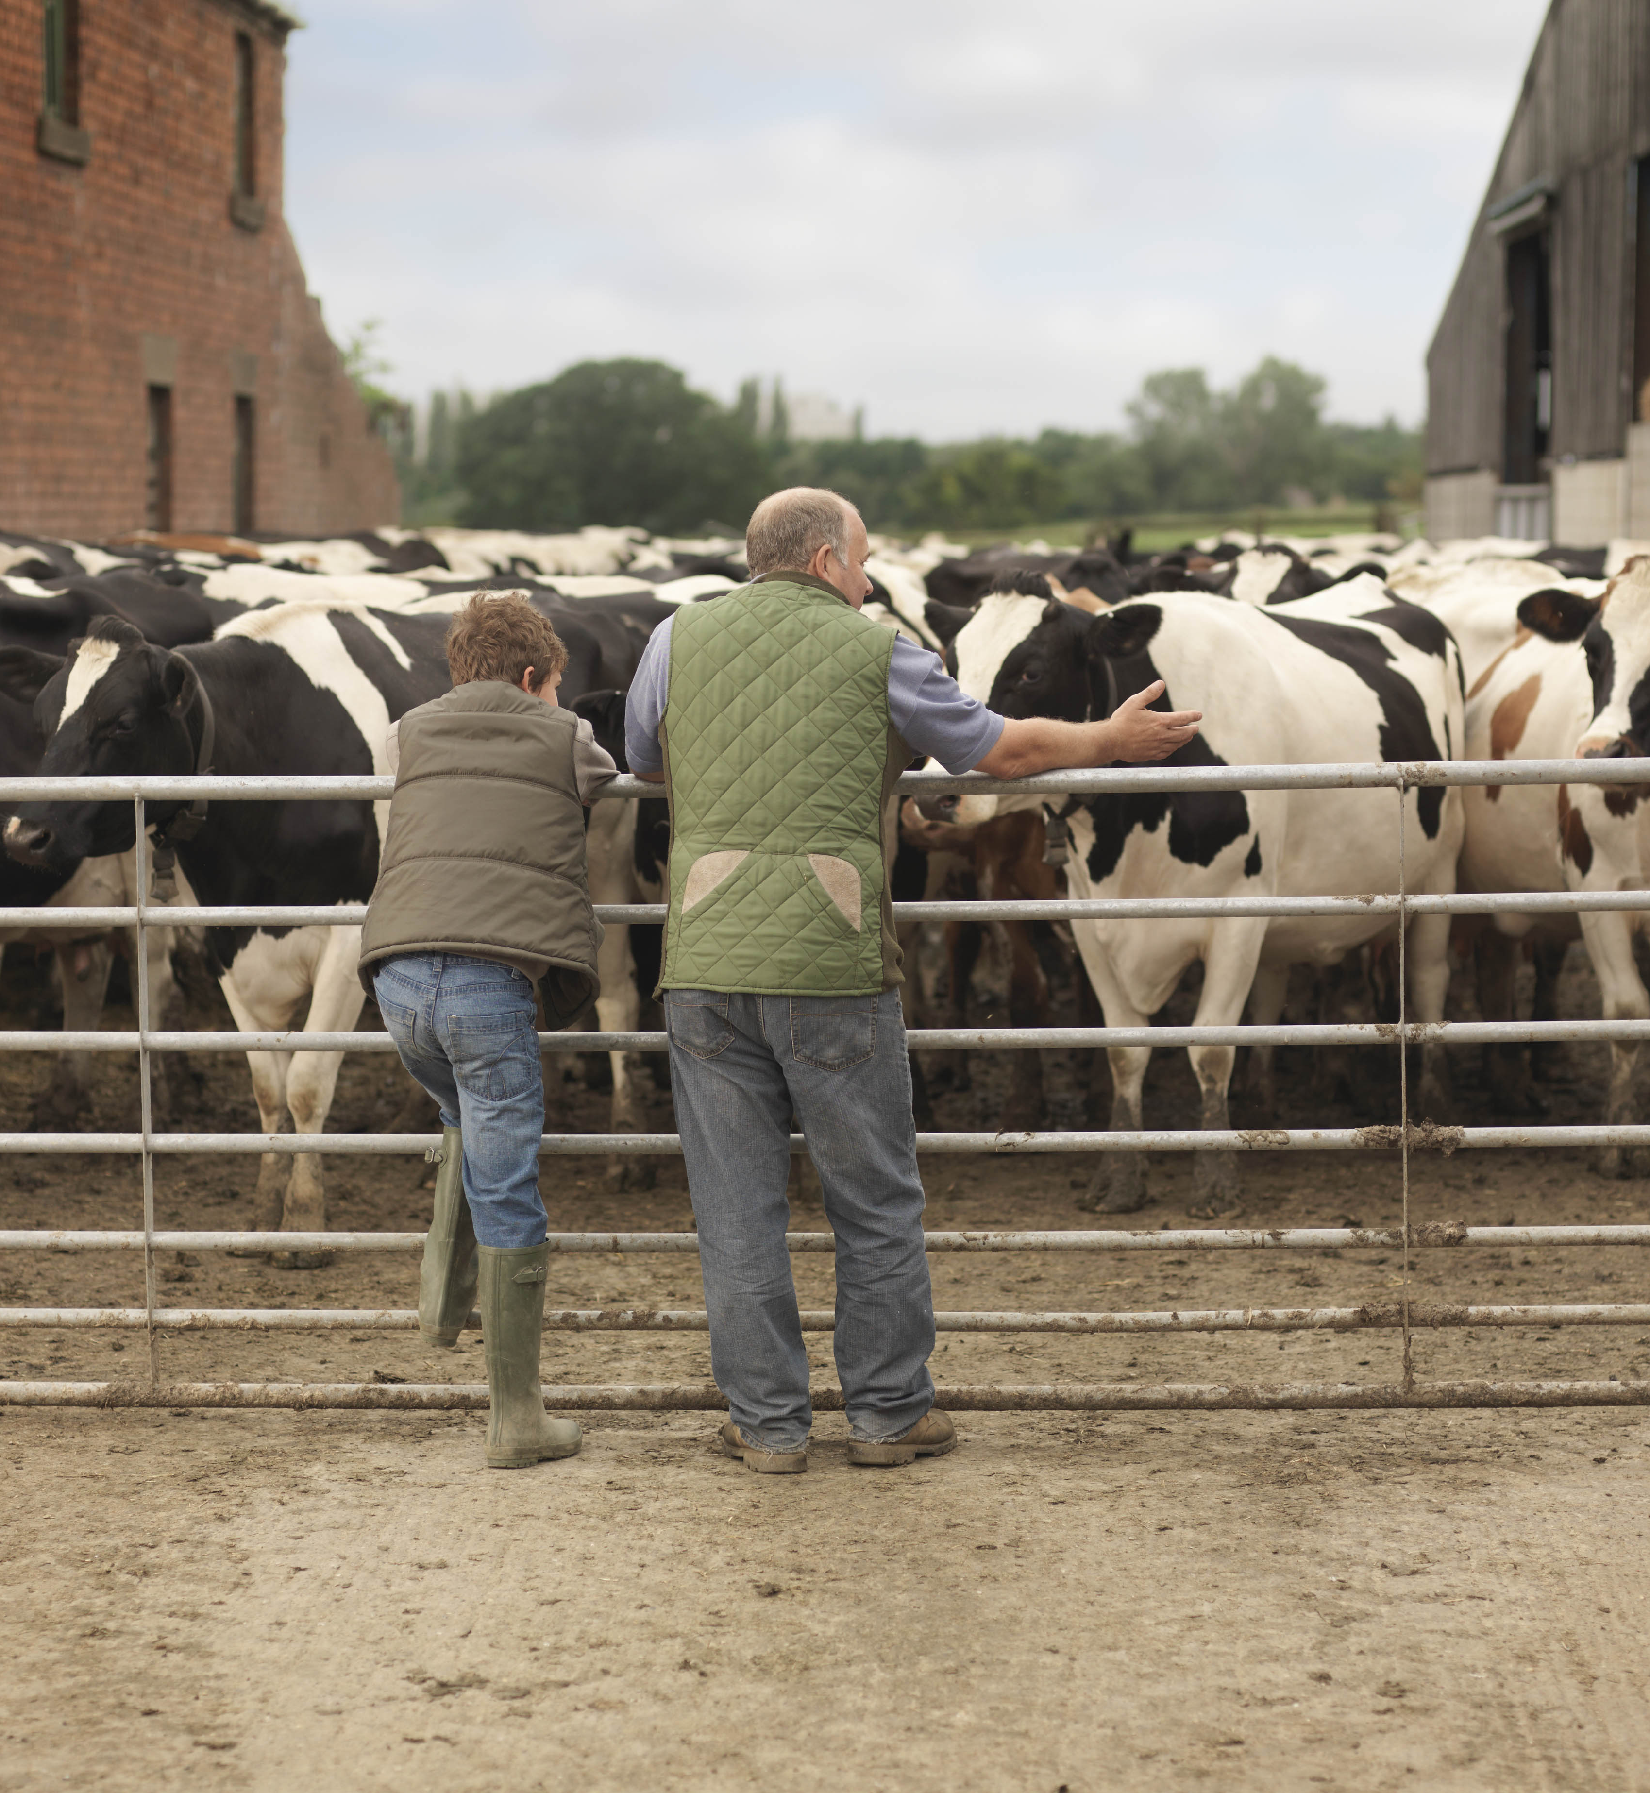
Farmer Mac
Created in the Farm Credit Act
Shares FCA as regulator with FCS
GSE that is a secondary market for agricultural loans
Purchases and pools qualified loans. May sell them to investors as securities, or hold them in its own portfolio.
Risk management tools for lenders to make more loans and satisfy regulatory requirements
Financially and organizationally separate from FCS
An investor-owned corporation
Total business volume: $24.5 billion, mostly farm and ranch loans, followed by rural utilities, corporate agricultural finance, and renewable energy loans
Market share of farm loans: about 2% directly
Credit: Jim Monke
Notes:
Last entity that I want to describe is Farmer Mac
Investor-owned corporation, separate from the Farm Credit System.
Share its regulator (FCA) with the FCS, and shares its place in the U.S. Code and the Farm Credit Act, and shares its committee of jurisdiction.

Slide 14
Proposed Changes in H. R. 8467
Reauthorize appropriations and make several changes to provisions.
Increase maximum loan limits to individuals and entities who borrow from the Farm Service Agency.
Permits Farm Credit System (FCS) to make loans for essential community facilities.
Expand qualified loans for Farmer Mac.
Heirs property relending expansion.

